Slide 1
Administration Reports Tool
March 2012

Slide 2
What Is the Administration Reports Tool?
Customers have requested reports to provide administrative details. The Administration Reports Tool provides System Administrators and End Users with the ability to generate on-demand reports on users, accounts and entitlements
The Administration Reports Tool allows reports to be easily generated at any time of the day.
These reports assist customers in responding to SOX or audit requirements.

Slide 3
Setup & Entitlement

Slide 4
Setup & Entitlement
Staff Hexagon
No setup or entitlement required, available to all customers by default
HSBCnet
Macro-level entitlement under the “Administration Reports” section

Slide 5
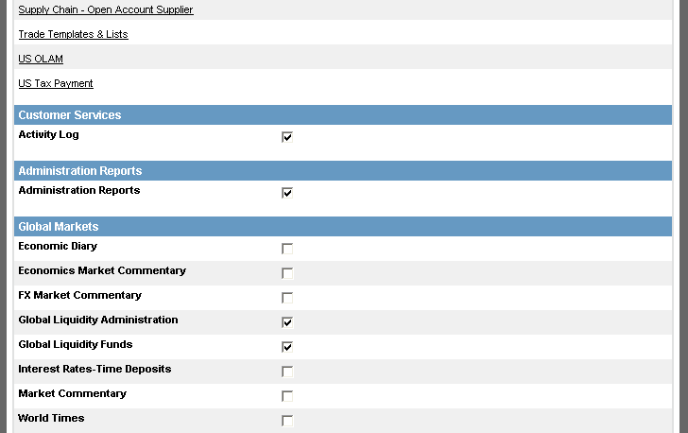
Setup & Entitlement - HSBCnet
Select the Administration Reports checkbox to entitle the user

Slide 6
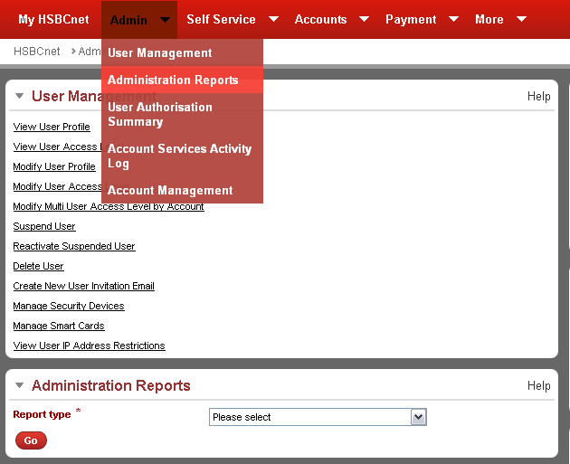
Setup & Entitlement - HSBCnet
Once entitled, you can access the Administration Reports tool under the Admin tab.

Slide 7
How Does It Work?

Slide 8
Common Data Fields
All reports contain the following common data:
Customer Name
Institution Name
Country Code
Report generated by (username)
Pages x of y and date/time
All dates in ddmmyyyy format (consistent with other HSBCnet reports)
All times in GMT (consistent with other HSBCnet reports)
PDF reports will also contain
HSBCnet header and report name
End of report on last page

Slide 9
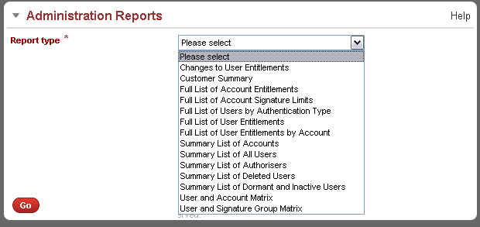
How Does It Work?
Use the drop-down list to select the report you wish to generate
After selecting a report, the screen automatically refreshes. It displays any applicable filter options to help you select the report criteria.

Slide 10
Report Types

Slide 11
Report Types
There are multiple reports available for customers available in 3 formats (PDF, CSV, Excel):
Changes to User Entitlements
Customer Summary
Full List of Account Signature Limits
Full List of Account Entitlements
Full List of Users by Authentication Type
Full List of Security Devices
Full List of User Entitlements
Full List of User Entitlements by Account
Summary List of Accounts
Summary List of All Users
Summary List of Authorisers
Summary List of Deleted Users
Summary List of Dormant and Inactive Users
User and Account Matrix
User and Signature Group Matrix

Slide 12
Changes to User Entitlements

Slide 13
Changes to User Entitlements
This report details a complete list of all user entitlements within a customer profile.
Only user initiated changes will be included.
Only authorised entitlement changes will be reported
Entitlement changes pending authorisation will be excluded from the report
The report consists of six sections:
Report Header
Account Level Entitlement Changes
Account Level Entitlement Changes – Self Service Transaction Limits
General / Administrative / Common Service Entitlement Changes
User Authorisation Limit Changes
Authority Details Key
Notes:
Note report details:
This report was introduced with R23, as a result, entitlement change activity performed prior to R23 (Jun. 26th 2010), will not be recorded in the reports.
Additional information for each section:
The following data is common across more than one section listed above:
User information
Account information
Maintenance history (Initiated by, First Authorised, Final Authorised, etc…)
Additional details for each section:
Report Header
Contains general report information consistent with existing administration reports
Account Level Entitlement Changes
Details the changes to entitlements for all tools and services entitled at account level. (BTR, Payments, Self Service, etc…)
Account Level Entitlement Changes – Self Service Transaction Limits
Certain Self Service tools which are entitled at account level have individual transaction limits which can be specified for each account. This section will provide the change details for those tools
General / Administrative / Common Service Entitlement Changes
This section will detail all other entitlement changes which are not entitled at individual account level.
User Authorisation Limit Changes
This section will detail all daily authorisation limit changes for each applicable service (ACH, Priority Payments, Inter-Account Transfers, etc…)
Authority Details Key
Entitlement changes will be marked using pre-defined codes (EQ, AR, AS, etc…) a definition of these codes will be provided in this section which is located at the end of the report.

Slide 14
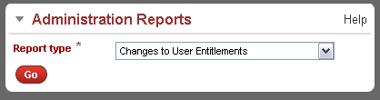
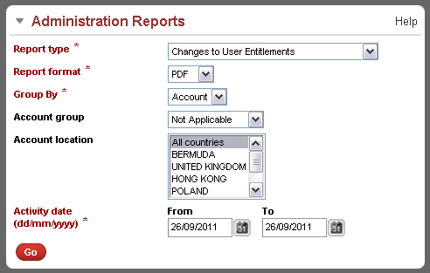
Changes to User Entitlements
After selecting the report from the drop-down list, the page refreshes displaying additional report filter options.
Notes:
Notes:
This screenshot example demonstrates what happens on screen when the “Changes to User Entitlements” report type is selected.
User will need to wait for the screen to reload before the additional report options are displayed.

Slide 15
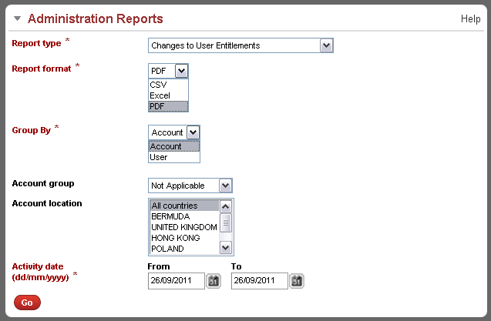
Changes to User Entitlements
Use the drop-down list to select the format of the report
The report information can either be grouped by Account or by User
The report can also be filtered by account group and/or account location. Use the drop-down list to select which account group (if any), and the account countries to include in the report.
Specify the date range to include in the report.
Notes:
Note about “Group By” field:
The “Group By” option will only be available when the selected report format is PDF or Excel. The “Group By” option is not supported by the CSV format
Note about date range:
There will be no date range restriction on the generated report, however, there will be a size restriction:
If a report contains too much data, a partial report will be generated and the following message will be attached to the report header:
"The report you have requested contains too much data. A partial report has been generated containing the first 10,000 records. Please adjust your date range and re-generate a new report.”
Important report generation note:
If a report takes too long to generate (more than 8 minutes), the generation process will time out and an error message will be displayed advising the user to refine their report criteria.

Slide 16
Customer Summary

Slide 17
Customer Summary
The “Customer Summary” provides an overall summary of a Customer’s users, subscribed services, accounts and Security devices / Smartcards
The report will provide the following information:
Total number of all users
Number of SA (System Administrators)
Number of end users
Number of accounts
Number of smartcards issued
Number of security devices allotted
Services Subscribed

Slide 18
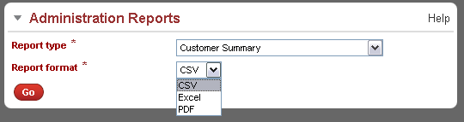
Customer Summary
After selecting the report type, select the format of the report
After making the selections click “Go” to generate the report

Slide 19
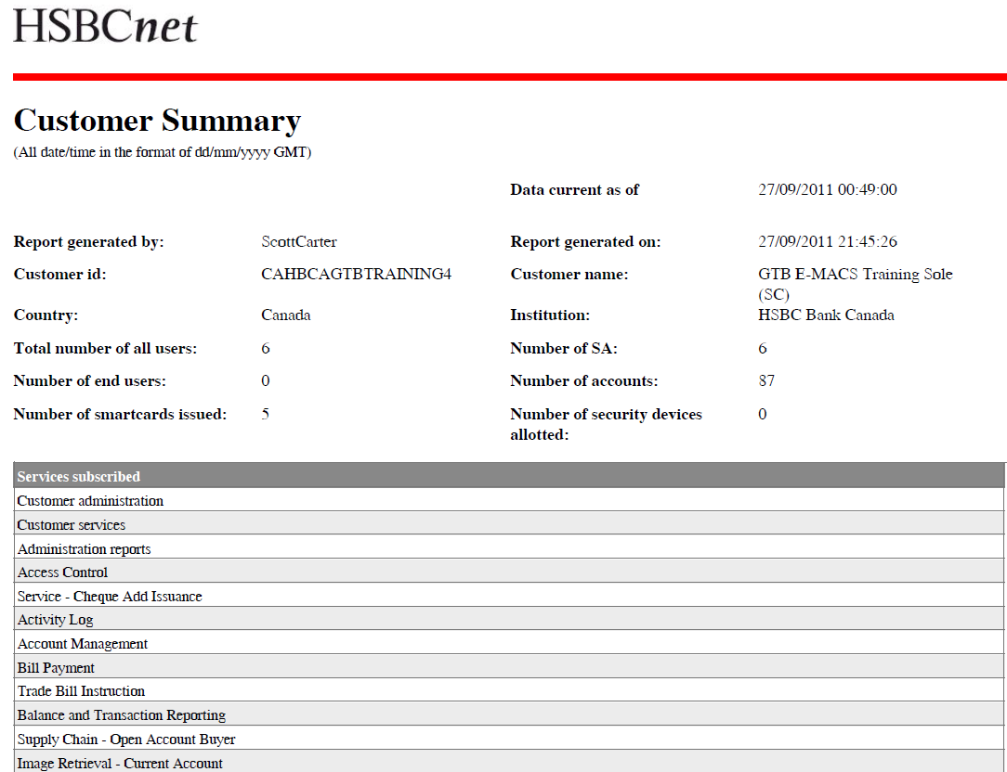
Customer Summary – Sample

Slide 20
Full List of Account Entitlements

Slide 21
Full List of Account Level Entitlements
This report lists all account level information like Account Transaction Controls, Account Signature Limit, and Account Service User Entitlements for a given customer.
Only approved entitlements will be shown in this report.

Slide 22
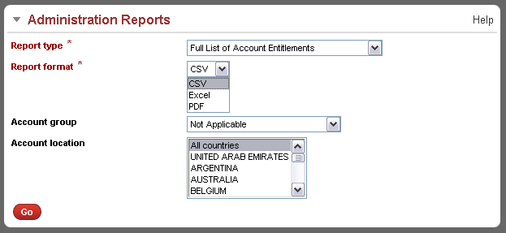
Full List of Account Entitlements
Use the drop-down list to select the format of the report
The report can also be filtered by account group and/or account location. Use the drop-down list to select which account group (if any), and the account countries to include in the report.
After making the selections click “Go” to generate the report

Slide 23
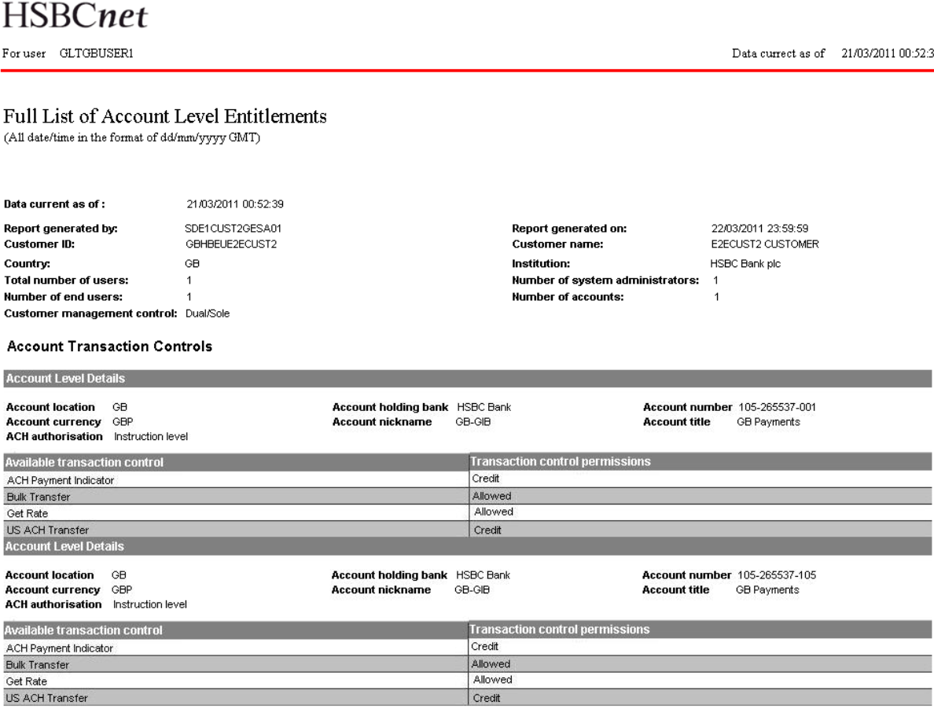
Full List of Account Entitlements

Slide 24
Full List of Account Signature Limits

Slide 25
Full List of Account Signature Limits
The “Full List of Account Signature Limits” report details all account signature limits which have been defined on the customer’s HSBCnet profile
The report contains the following data:
Institution Name & Location
Account Number
Account Title
For each account columns containing the following information are included:
Transaction Type (ie: Common Limits, Priority Payment etc.)
Account Currency (as per the Signature Group)
Signature Amount Limit
Last Modified Date

Slide 26
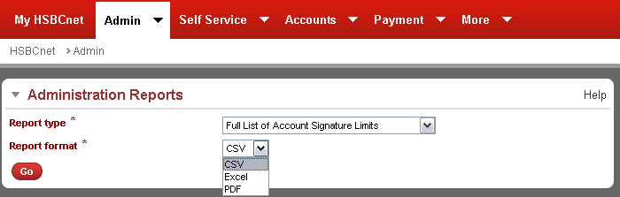
Full List of Account Signature Limits
After making the selections click “Go” to generate the report
After selecting the report type, select the format of the report

Slide 27
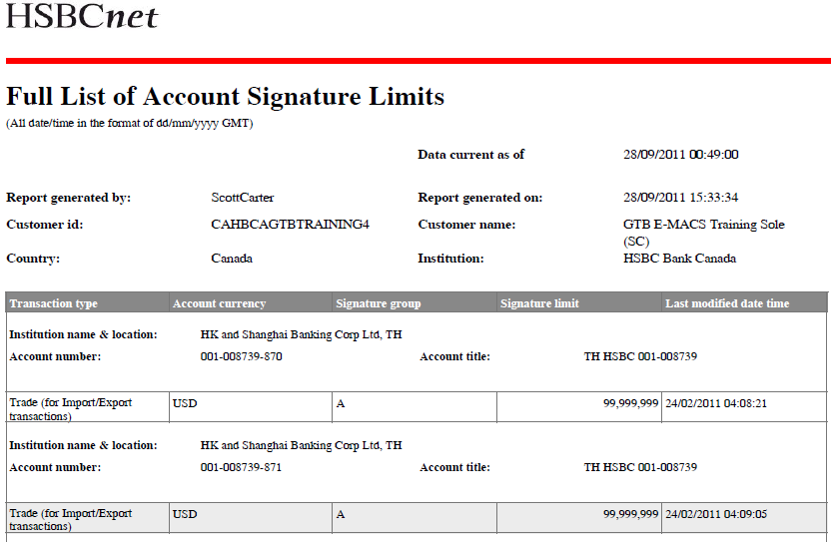
Full List of Account Signature Limits – Sample

Slide 28
Full List of Users by Authentication Type

Slide 29
Full List of Users by Authentication Type
The “Full List of Users by Authentication Type” report lists all users under a customer profile and separate them based on their selected authentication type.
This report is only available/visible to customers who’s CAP profile is set as “Mixed Security”
In addition to the standard report information, this report also contains the following information:
Smartcard / Security Device Serial Number
Smartcard Expiry Date
Smartcard / Security Device Status
First, Last and Username
User Type
Authentication Type

Slide 30
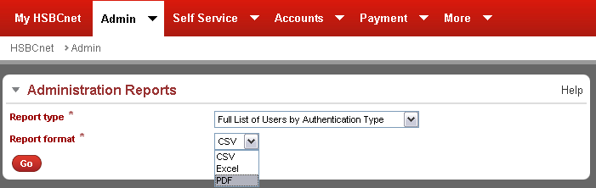
Full List of Users by Authentication Type
After making the selections click “Go” to generate the report
After selecting the report type, select the format of the report

Slide 31
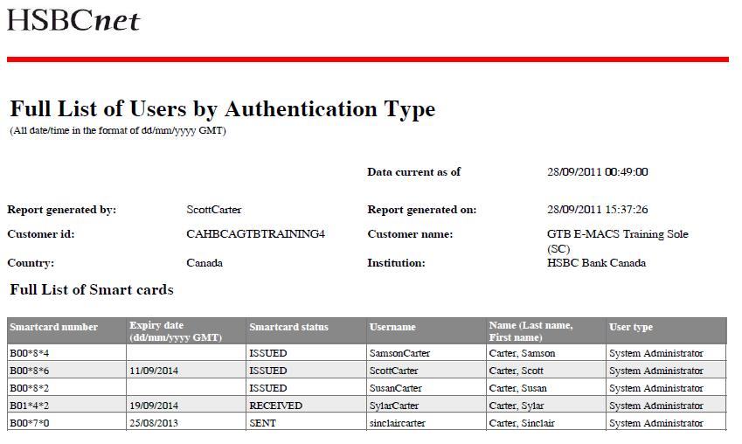
Full List of Users by Authentication Type
All Smartcards are listed first.

Slide 32
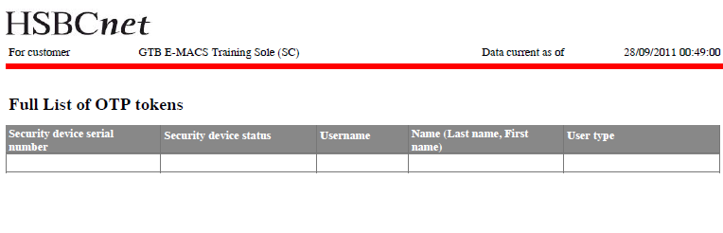
Full List of Users by Authentication Type
All OTP tokens (Security Devices) both allocated and unallocated, are listed in the next section on a separate page

Slide 33
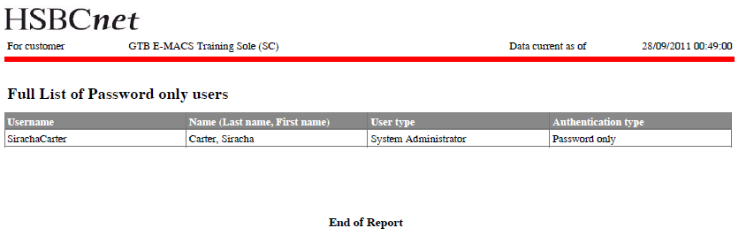
Full List of Users by Authentication Type
The final section and page lists all users whose authentication type is “Password Only”

Slide 34
Full List of Security Devices

Slide 35
Full List of Security Devices
The “Full List of Security Devices” report lists all Security Devices and which username it is currently associated with.
This report is only available/visible to Customers whose CAP profile is set as “OTP” (Security Devices)
The report contains the following information:
Security device serial number
Security device status
Username
Name (Last name, First name)
User type

Slide 36
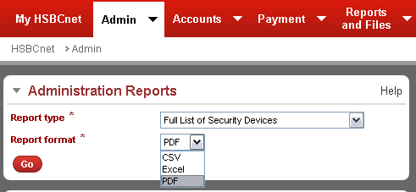
Full List of Security Devices
After selecting the report type, select the format of the report
*Note: This report is not visible to “Mixed Security” customer profiles
After making the selections click “Go” to generate the report

Slide 37
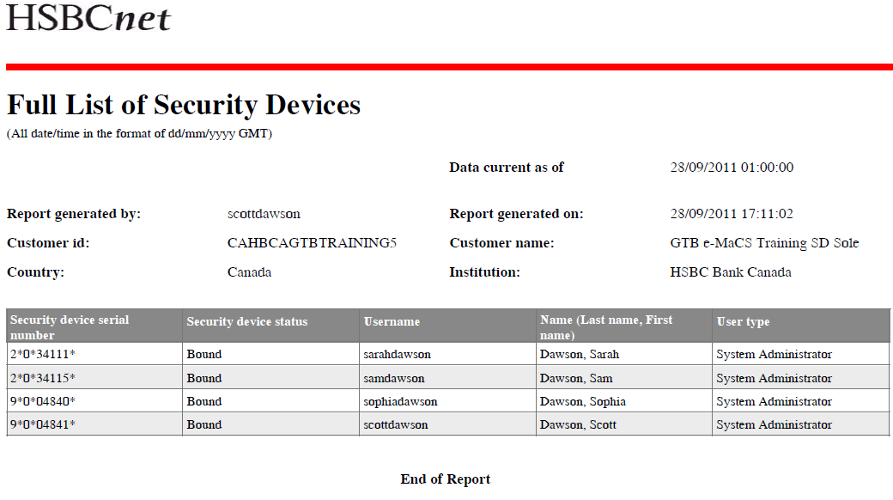
Full List of Security Devices – Sample

Slide 38
Full List of User Entitlements

Slide 39
Full List of User Entitlements
The “Full list of User Entitlements” report provides a list of the selected user’s complete entitlements.
The report can be generated in PDF format only
The report contains the following information:
Username
Type (user type)
Status
User and Signature Group
Service Authorisation Limit
Account Transaction Limit
Administration / Common Entitlements
General Service Entitlements
Automated File Delivery (mail domain names allowed)
Account Service Entitlements

Slide 40
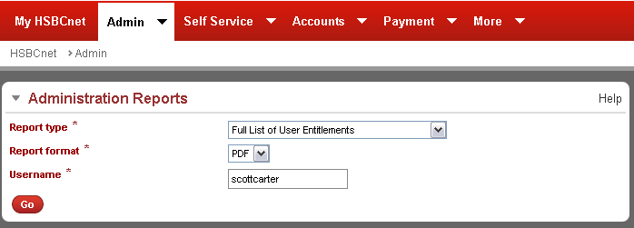
Full List of User Entitlements
In the field provided, specify which username you would like to generate a report on.
Note: This report only supports PDF format.
After making the selections and specifying the username click “Go” to generate the report

Slide 41
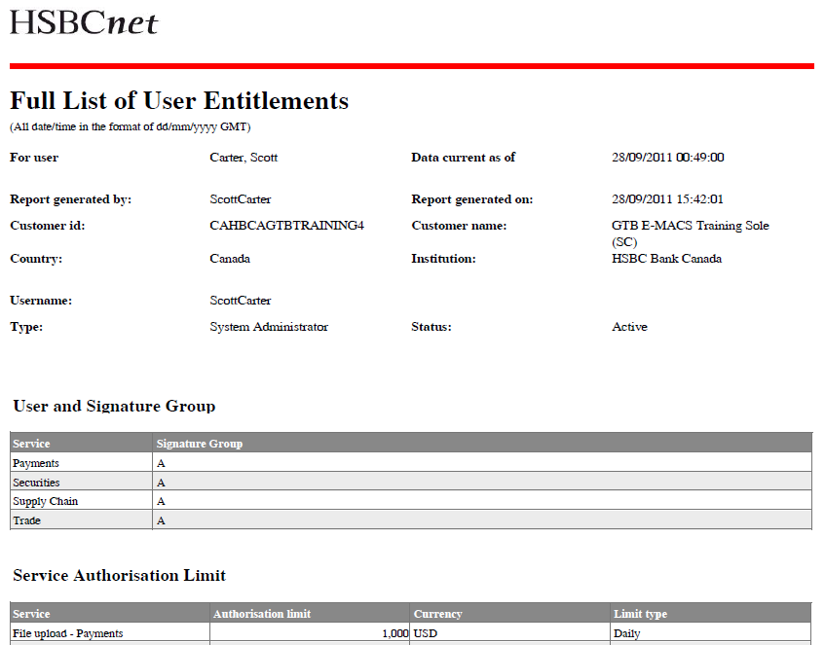
Full List of User Entitlements – Sample

Slide 42
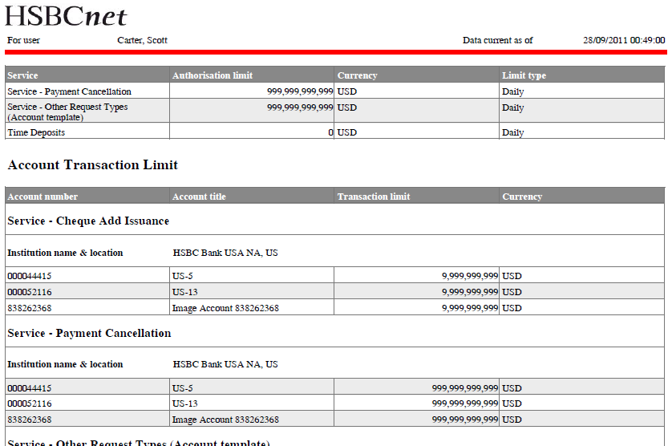
Full List of User Entitlements – Sample

Slide 43
Full List of User Entitlements by Account

Slide 44
Full List of User Entitlements by Account
The “Full List of User Entitlements by Account” report provides a complete breakdown of all users’ entitlements to the accounts on the customer’s profile.
Users are able to use filter criteria to select which accounts should be included in the report
Entitlement details are separated in two sections:
Account Service Entitlements
General/Administrative/Common Service Entitlements
The following information is included in the report:
Username, First & Last name
User Type, Status, creation date, Last Logon date/time
Account Service Name
Authority Details
Self Service Transaction Limit
Payment set code and description

Slide 45
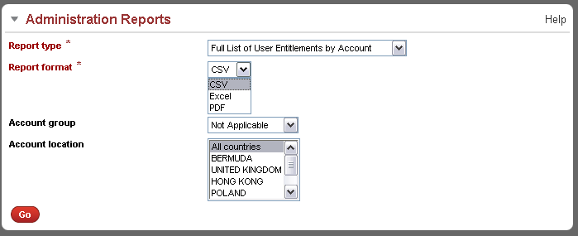
Full List of User Entitlements by Account
After selecting the report, use the drop-down menu to select the report format. The option to filter the report criteria by Account Group or Location is also available.

Slide 46
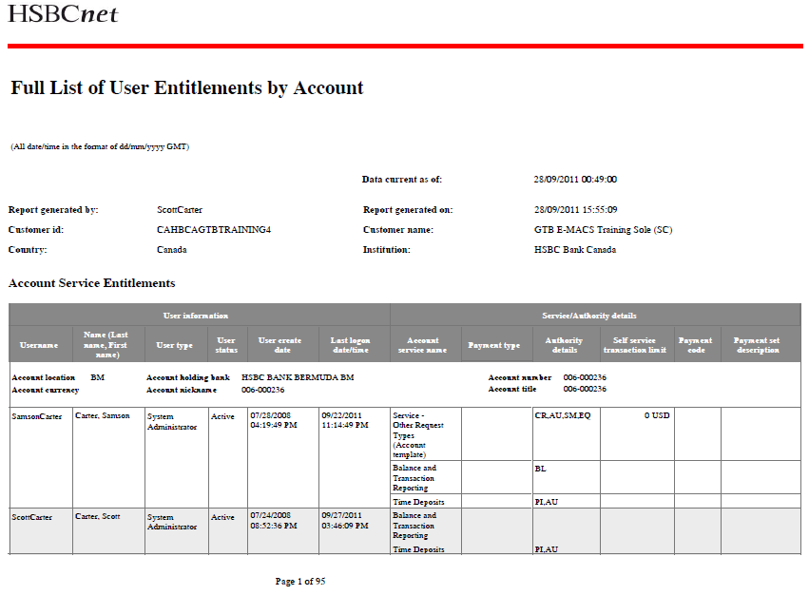
Full List of User Entitlements by Account

Slide 47
Summary List of Accounts

Slide 48
Summary List of Accounts
The “Summary List of Accounts” report provides a full list of all the accounts attached to the customer’s HSBCnet profile, and also details which services have been enabled for each individual account.
The report provides the following information:
Institution name and Location
Account Number
Account Title
Account Currency
Services Subscribed
Information is detailed at account level

Slide 49
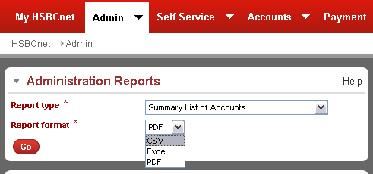
Summary List of Accounts
After selecting the report type, select the format of the report
After making the selections click “Go” to generate the report

Slide 50
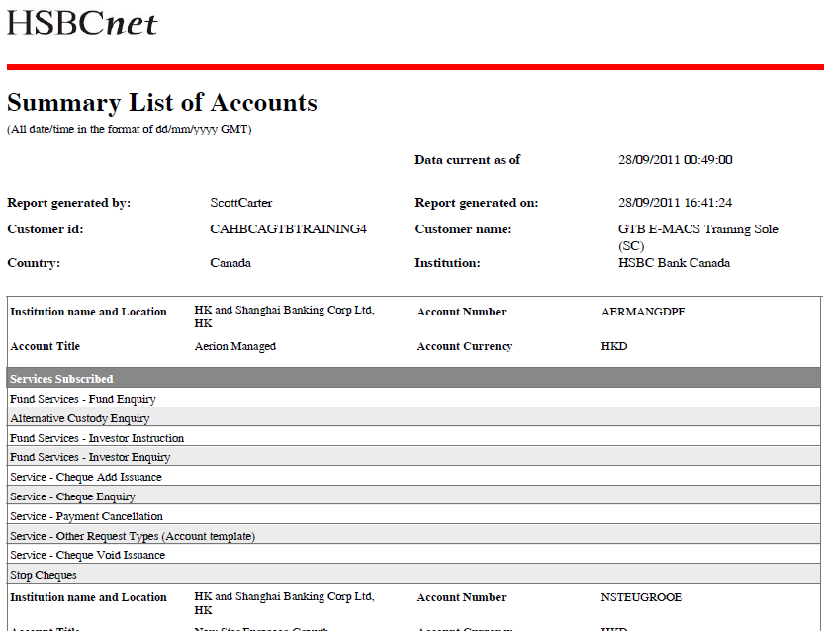
Summary List of Accounts – Sample

Slide 51
Summary List of All Users

Slide 52
Summary List of All Users
The “Summary List of All Users” report provides a list of all usernames attached to the customer profile.
The report contains the following data:
User ID
Name
Last name, First name
User Type
SA or EU, sorted first by SA then EU alphabetically within each group
User Status
Last Logon Date & Time
Last Modified Date
Date Registered
Overall total number of users

Slide 53
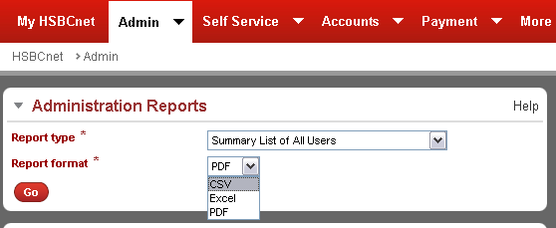
Summary List of All Users
After selecting the report type, select the format of the report
After making the selections click “Go” to generate the report

Slide 54
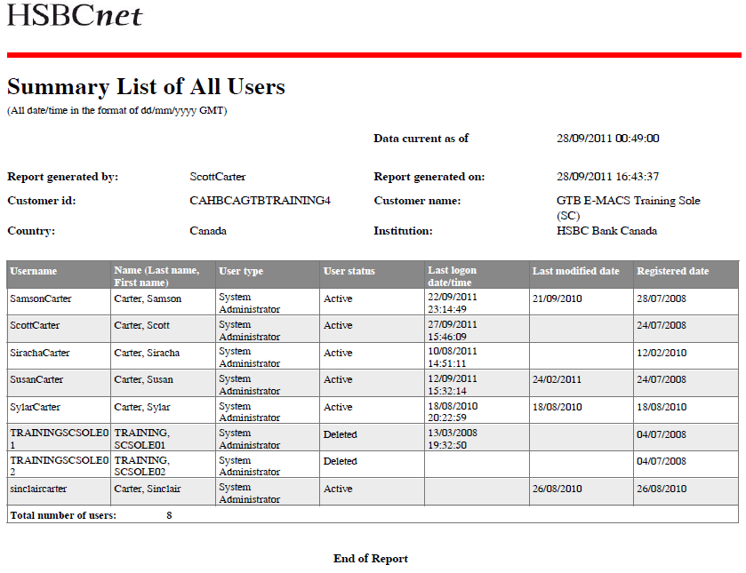
Summary List of All Users – Sample

Slide 55
Summary List of Authorisers

Slide 56
Summary List of Authorisers
The “Summary List of Authorisers” provides a list of users entitled with “Authorise” authority on any tool or service (excluding Global Markets) on HSBCnet.
Excludes deleted users

Slide 57
Summary List of Authorisers
The report contains the following information:
Username
Name (Last name, First name)
User Type
Registration status
Payment
Trade
Securities
Supply Chain
Smart card or security device assigned
Last logon date & time
Date registered
Last modified date
Last approved by

Slide 58
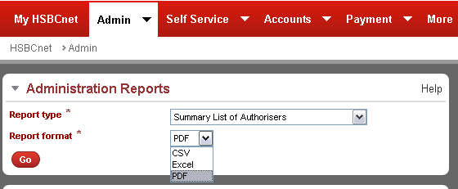
Summary List of Authorisers
After making the selections click “Go” to generate the report
After selecting the report type, select the format of the report

Slide 59
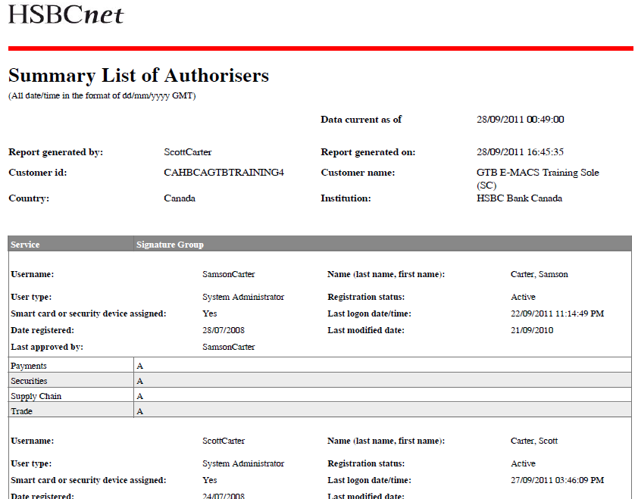
Summary List of Authorisers – Sample

Slide 60
Summary List of Deleted Users

Slide 61
Summary List of Deleted Users
The “Summary List of Deleted Users” provides a report of all usernames deleted from a customer’s HSBCnet profile.
The report contains the following data:
User ID
Name
Last Name, First Name
User Type
SA or EU, sorted first by SA then EU alphabetically within each group
Date Registered
Deleted Date
Deleted By
Deletion Approved By

Slide 62
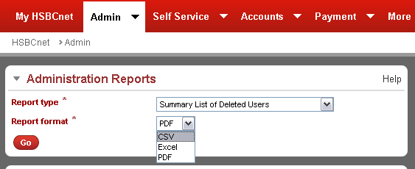
Summary List of Deleted Users
After selecting the report type, select the format of the report
After making the selections click “Go” to generate the report

Slide 63
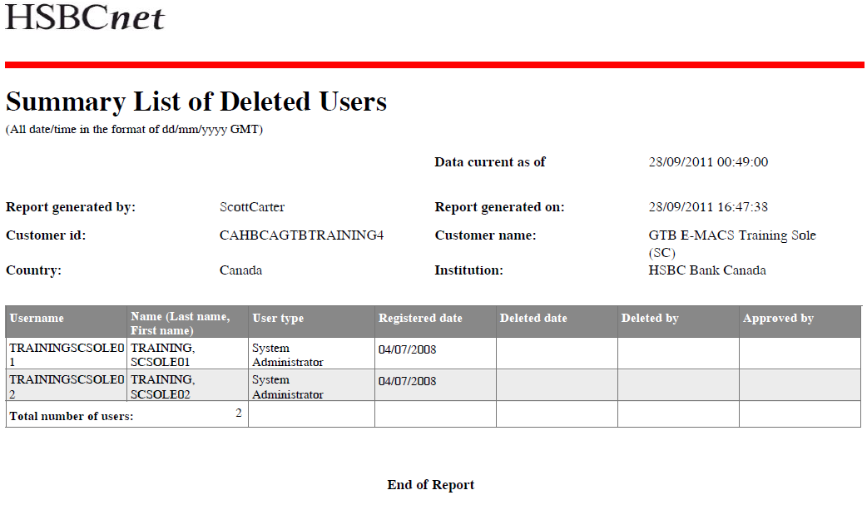
Summary List of Deleted Users – Sample

Slide 64
Summary List of Dormant & Inactive Users

Slide 65
Summary List of Dormant & Inactive Users
Summary List of Dormant & Inactive Users report contains information on
All users whose status is not ‘Active’
All users whose status is ‘Active’ but never logged on
All users whose status is ‘Active’ who has not logged on for 30 days
Data contained in the report:
User ID
Name
Last name, First name
User Type
SA or EU, sorted first by SA then EU alphabetically within each group
User Status
Last Logon Date & Time
Last Modified Date
Date Registered

Slide 66
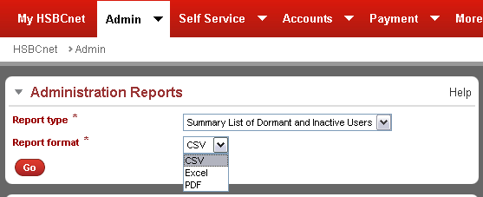
Summary List of Dormant & Inactive Users
After making the selections click “Go” to generate the report
After selecting the report type, select the format of the report

Slide 67
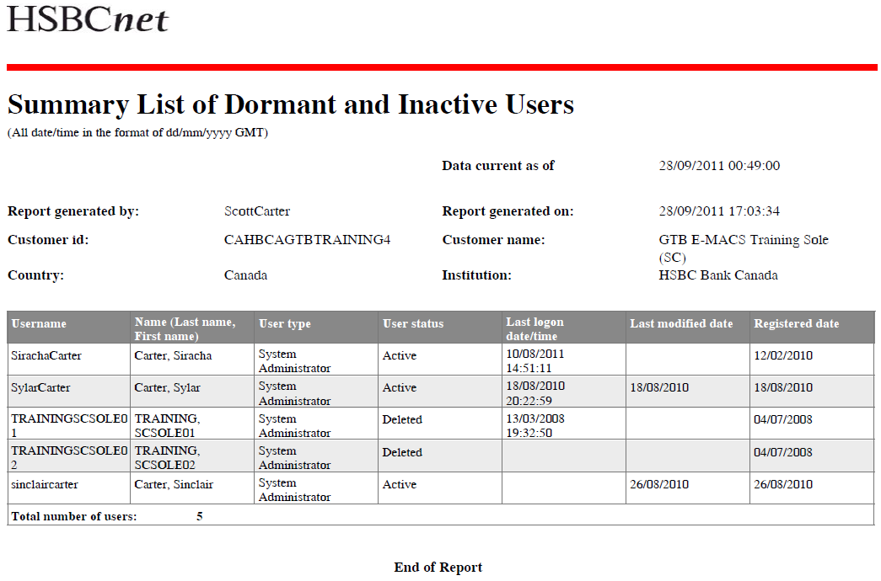
Summary List of Dormant & Inactive Users – Sample

Slide 68
User and Account Matrix

Slide 69
User and Account Matrix
The “User and Account Matrix” report provides a detailed view of the Customer’s usernames and their associated account access.
For each username, the report lists all accounts which the user is entitled to under any service or tool.
The report contains the following information:
Bank name
Account currency
Account number
Username
Name (Last name, First name)

Slide 70
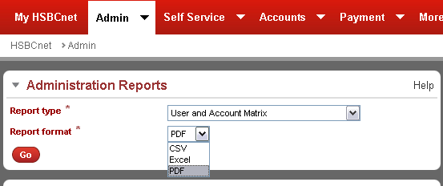
User and Account Matrix
After making the selections click “Go” to generate the report
After selecting the report type, select the format of the report

Slide 71
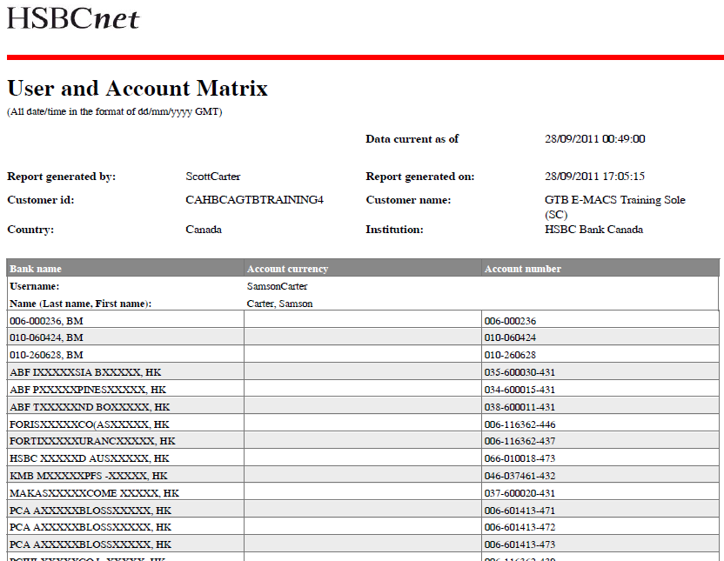
User and Account Matrix – Sample

Slide 72
User and Signature Group Matrix

Slide 73
User and Signature Group Matrix
The “User and Signature Group Matrix” report provides a list of the usernames on an HSBCnet customer profile detailing which signature group they are assigned to for:
Payments
Trade
Securities
Supply Chain
The report contains the following data:
User ID
User Name
Last name, First name

Slide 74
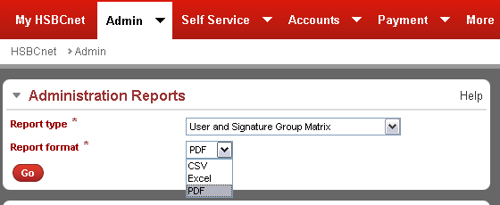
User and Signature Group Matrix
After making the selections click “Go” to generate the report
After selecting the report type, select the format of the report

Slide 75
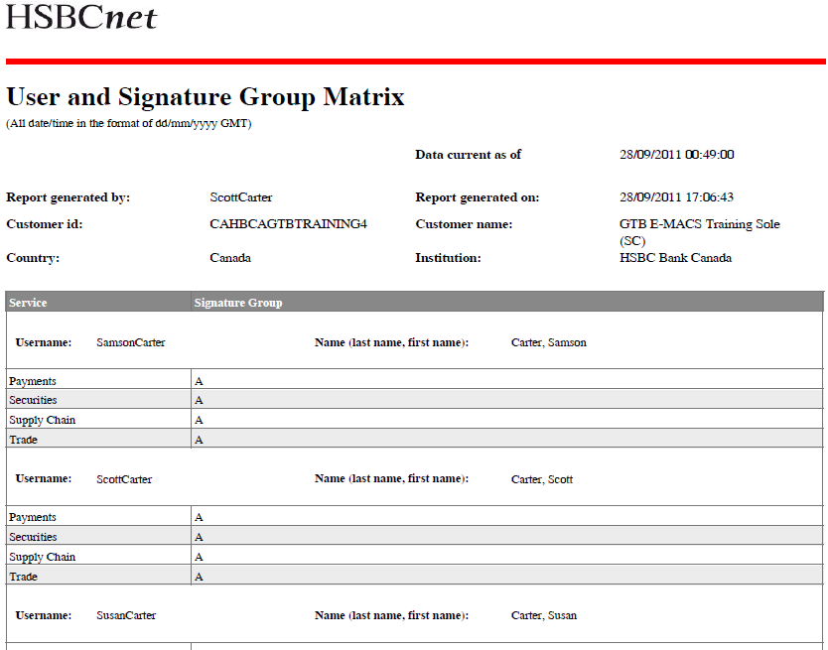
User and Signature Group Matrix – Sample

